Slide 1

WEP-WPA Attacks
Yunus Teke
CEIT 215

Slide 2


Understanding WEP-WPA Attacks
Welcome! Exploring Wi-Fi Security: WEP & WPA.
Objective: Understanding Protocol Weaknesses & Exploits.

Slide 3

Overview of WEP (Wired Equivalent Privacy)
WEP: Initial Wi-Fi encryption.
Introduced in 1997. Uses RC4 encryption.
Flawed design, vulnerable to attacks.

Slide 4

Weaknesses in WEP
Vulnerabilities making WEP susceptible.
Static encryption keys, poor IV implementation.
Lack of robust authentication.

Slide 5
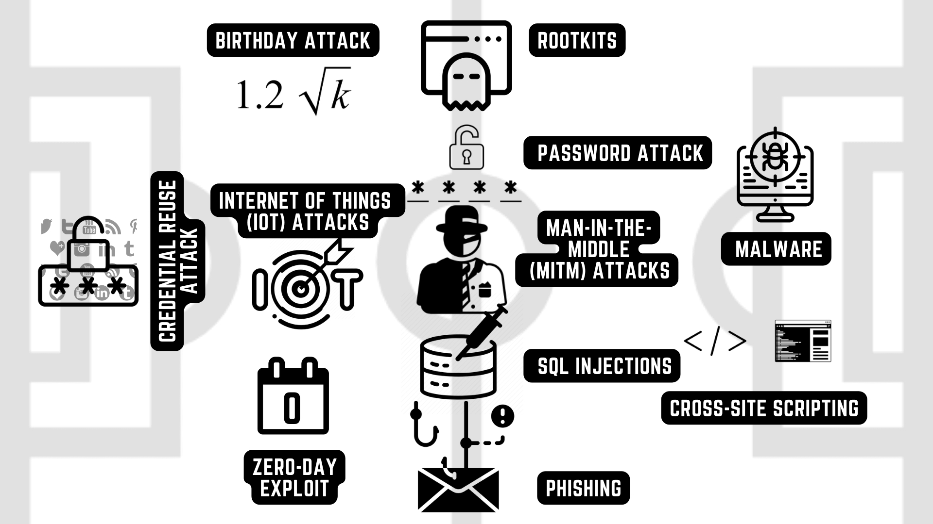
Types of WEP Attacks
Attacks exploiting WEP vulnerabilities.
WEP Key Cracking via Weak IVs: Exploiting weaknesses in the initialization vector (IV) to crack encryption keys.
ARP Poisoning: Manipulating ARP messages to associate the attacker's MAC address with the IP address of a legitimate device.
Fragmentation Attacks: Exploiting flaws in the way WEP handles fragmented packets to reveal key information.
Replay Attacks: Capturing and retransmitting data to perform unauthorized actions or gain access.

Slide 6
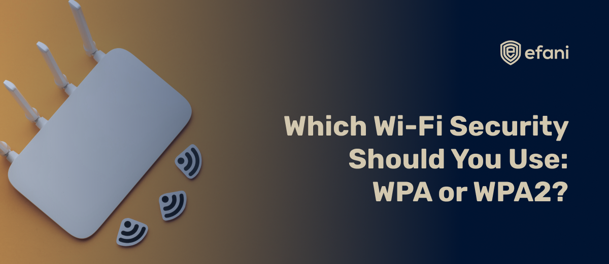
Transition to WPA (Wi-Fi Protected Access)
WPA: Improved security over WEP.
Replaced WEP in 2003 with superior encryption algorithms.
Aimed to address and rectify the vulnerabilities present in WEP.

Slide 7

Weaknesses in WPA
Despite improvements, WPA is not without vulnerabilities.
WPA-PSK (Pre-Shared Key) Weaknesses: Vulnerabilities in shared key authentication.
WPA Handshake Exploitation: Exploiting the handshake process to compromise security

Slide 8
Types of WPA Attacks
Attacks leverage weaknesses in WPA security.
Brute Force on PSK: Repeated attempts to crack the passphrase.
WPA Handshake Capturing and Cracking: Capturing and decrypting the WPA handshake.
Dictionary Attacks: Attempting to guess passwords using dictionaries.

Slide 9

Mitigation Strategies
Enhancing Wi-Fi security against potential attacks.
Upgrade to WPA2 or WPA3 for improved security measures.
Employ strong and complex passwords/passphrases.
Regular firmware updates and security patches.
Implement additional security measures like VPNs for added protection.

Slide 10
Conclusion
In closing, our exploration revealed critical vulnerabilities within WEP and residual weaknesses in the more secure WPA protocols. Recognizing WEP's extreme insecurity and the need for constant vigilance with WPA is paramount. Our key takeaways emphasize the necessity of regular updates, the implementation of robust security measures, and the adoption of stronger protocols like WPA2 or WPA3. By prioritizing these practices, we fortify our networks against potential threats, ensuring a more resilient and secure Wi-Fi environment.

